Slide 1

Acropolis Institute of Technology & Research, Indore
www.acropolis.in

Slide 2
AutoValuator: Car Price Prediction Model
Submitted to: Department of Computer Science and Engineering

Slide 3

Team Members 1. PRIYANSHI GOYAL
2. RACHIT SHIVHARE RAHUL SHARMA PRANAY JAIN
Supervised by:
Prof. Krupi Saraf
3.
4.

Slide 4
Project Presentation Outline
Introduction
Problem Statement
Survey of Existing Systems
Project Objectives
Requirement Analysis
Solution Proposed
Features
System architecture
User Interface
Testing Plan
The Outcome Discussion
Conclusions

Slide 5
Introduction
Our solution, AutoValuator, is a smart web platform that automates the evaluation process for cars using a simple form-based system.
It collects user input (like car model, year, mileage, fuel type, etc.) and provides instant evaluation results.
The platform simplifies decision-making by generating downloadable reports and performance summaries.
It saves users time, removes guesswork, and improves accuracy by centralizing car evaluation in one place.
Accessible from any device, AutoValuator is built to assist car buyers, sellers, and evaluators with an easy-to-use, reliable system.

Slide 6
The Problem Statement
The Problem:
Users often struggle to determine the fair value of used cars manually.
They have to browse multiple car listing websites or consult experts to get an estimate.
The Solution:
AutoValuator offers a one-stop platform for automatic car evaluation.
The platform removes the need to switch between sites or rely on guesswork.
Users save time and avoid switching between websites.

Slide 7
Survey of Existing Systems
CarDekho
Problems Addressed: Used car valuation, car comparison, and price check Advantages: Instant car value estimation, brand-wise filters Disadvantages: Requires login for full valuation report Gaps Identified: No feature-wise detailed valuation, no document-based input Reference Link: https://www.cardekho.com/
2. Cars24
Problems Addressed: Car selling, buying, and valuation Advantages: Quick valuation, door-step car inspection Disadvantages: Limited transparency in valuation calculation Gaps Identified: No AI-based pricing, lacks custom feature input by users Reference Link: https://www.cars24.com/

Slide 8
3. Spinny Problems Addressed: Certified used car sales and car value estimation Advantages: Hassle-free selling, fair price assurance, home test drive Disadvantages: Valuation slightly biased towards their resale price models Gaps Identified: No open valuation access for general users, no document upload system Reference Link: https://www.spinny.com/ 4. CarTrade Problems Addressed: Vehicle listings, price checks, and car comparison Advantages: Wide network of dealers, detailed vehicle listings Disadvantages: Slower valuation process, outdated UI Gaps Identified: No real-time AI-based evaluation, lacks input customization Reference Link: https://www.cartrade.com/
Survey of Existing Systems

Slide 9
Objectives
Build a smart platform that can predict the price of a car based on user input.
Help users know the estimated market value of used cars easily.
Use machine learning to make accurate and quick predictions.
Allow users to input car details like brand, model, year, fuel type, and kilometers driven.
Make car buying and selling decisions easier and more informed.

Slide 10
Requirement Analysis
Functional Specifications:
User Input: Users can enter car details like brand, model, year, fuel type, etc.
Input Validation: System checks if all required fields are filled correctly.
Price Prediction: Predicts the estimated car price using a trained ML model.
Result Display: Shows the predicted price clearly on the screen.
Downloadable Reports: Displays reports of estimated price and downloads it for user.

Slide 11
Non-Functional Specifications: 1. Performance: System gives results within a few seconds. 2. Usability: Interface is clean, responsive, and easy to use. 3. Compatibility: Works on both desktop and mobile browsers. 4. Accuracy: Provides reliable and accurate predictions. 5. Scalability: Can handle larger datasets in future updates.
Requirement Analysis

Slide 12
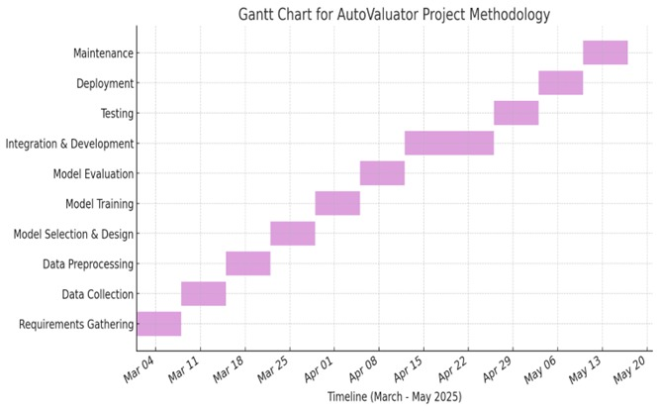
Solution Proposed
AutoValuator acts as a Car Price Predictor which predicts the selling price of car.
Methodology includes:
Data Collection
Data Preprocessing
Feature Selection
Data Splitting
Model Building
Model Evaluation
Visualization

Slide 13
Features
Form-Based Car Data Entry:
Users can enter car details such as brand, model, year, fuel type, transmission, and kilometers driven through a simple and intuitive form.
2.ML-Based Price Prediction:
The system uses trained Machine Learning models like Linear Regression or Random Forest to predict the estimated resale value of the car accurately.
3. Instant Report Generation:
After submitting the car details, users receive a detailed evaluation report including estimated price, model info, and confidence range
4. Data-Driven Decision Support:
The platform helps users make informed decisions by evaluating current market trends, historical data, and similar car listings.
5. Simple & User-Friendly Interface: Designed with a clean and intuitive layout, users can smoothly navigate through the evaluation process without any technical hassle.

Slide 14
System Architecture
The system architecture of this project is made up of two main parts that work together to make the platform run smoothly:
Frontend (User Interface):
This is what users see and interact with. It allows them to enter car details such as brand, model, year, fuel , type, transmission, and kilometers driven through a clean and simple form.
This is built using ReactJS and CSS.
2. Backend (Processing Engine):
This part takes the user input, runs it through a trained Machine Learning model, and returns the estimated price of the car.
Developed using Python, the backend receives car details, loads the trained ML model (like Decision Regression or Random Forest), performs the prediction, and sends the result back to the frontend.

Slide 15
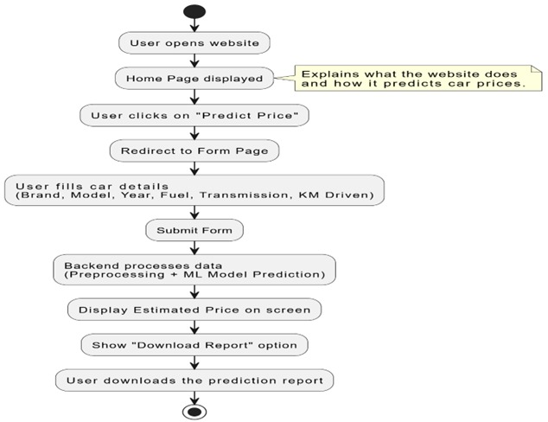
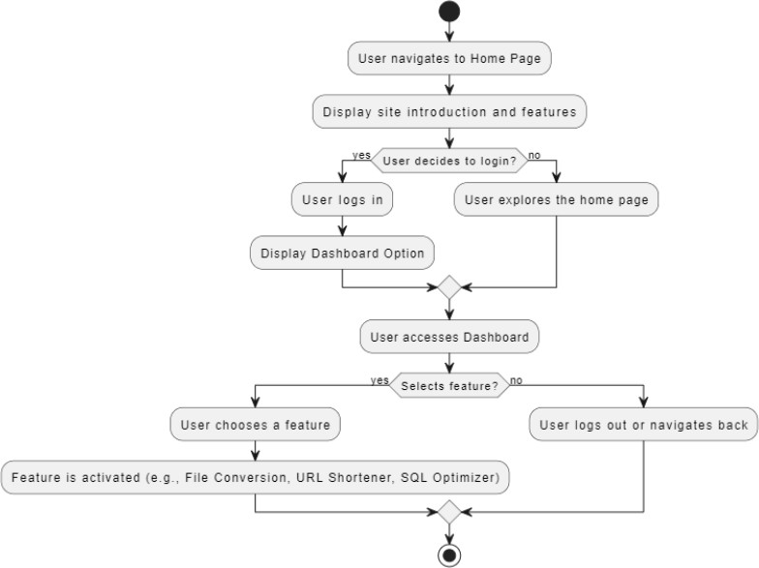
How They Work Together: 1. User Input: The user submits car details via the frontend form. 2. Backend Prediction: The backend processes this input using the ML model and calculates the car’s estimated selling price. 3. Response: The frontend displays the predicted price instantly to the user in a report format
System Architecture

Slide 16
User Interface
The User Interface (UI) of the AutoValuator platform is designed to be intuitive and beginner-friendly, ensuring users can easily predict their car’s price without any confusion or complexity.
Homepage:
• The homepage welcomes users with a clean, minimal layout.
• A prominent "Estimate Now" button is placed at the center to grab attention and guide users directly to the main feature.
• A simple top navigation bar allows users to navigate easily across the platform if needed.
2. Predict Price :
This page includes a form-based interface where users can fill in essential car details like:
Brand, Model, Year
Fuel Type, Transmission
KMs Driven, Ownership
Each field has a dropdown or input box with hints, making it easier even for non-technical users.
A “Get Estimated Price” button is shown at the bottom to submit the form.
3. Report Page (After Prediction):
Once the price is predicted using the ML model, users are taken to a new page showing the estimated car price.
A neat, card-style layout displays:
User’s input summary
Predicted price
A "Download Your Report" button allows users to save a PDF version of their car valuation.

Slide 17
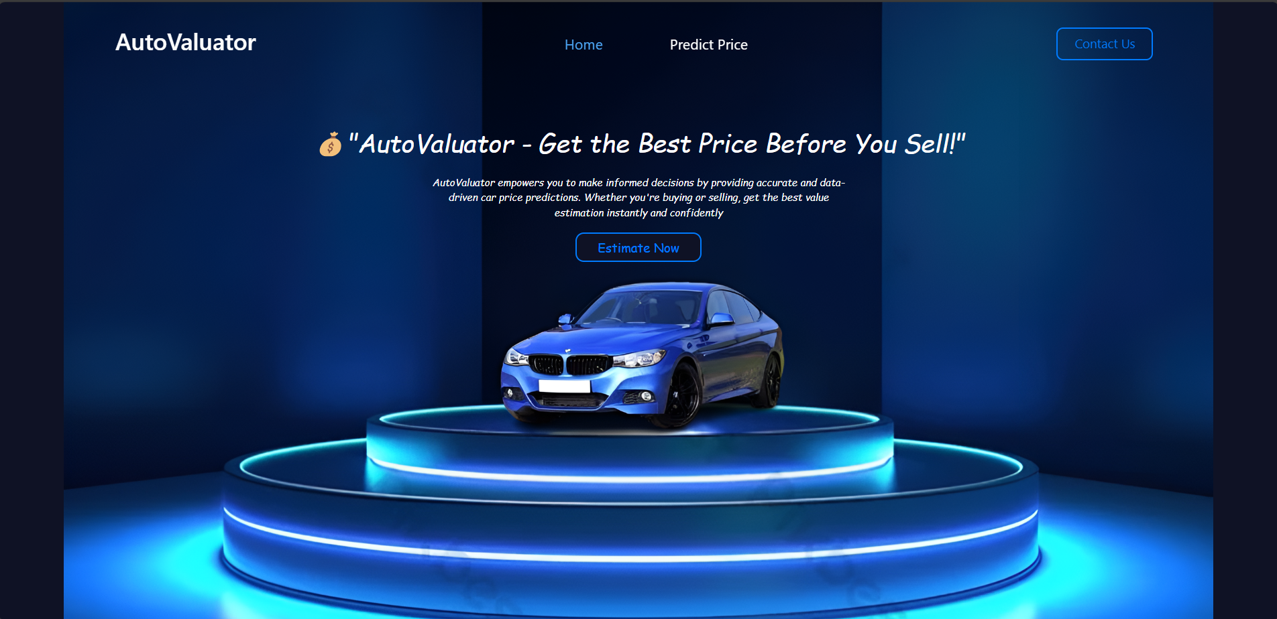
User Interface

Slide 18
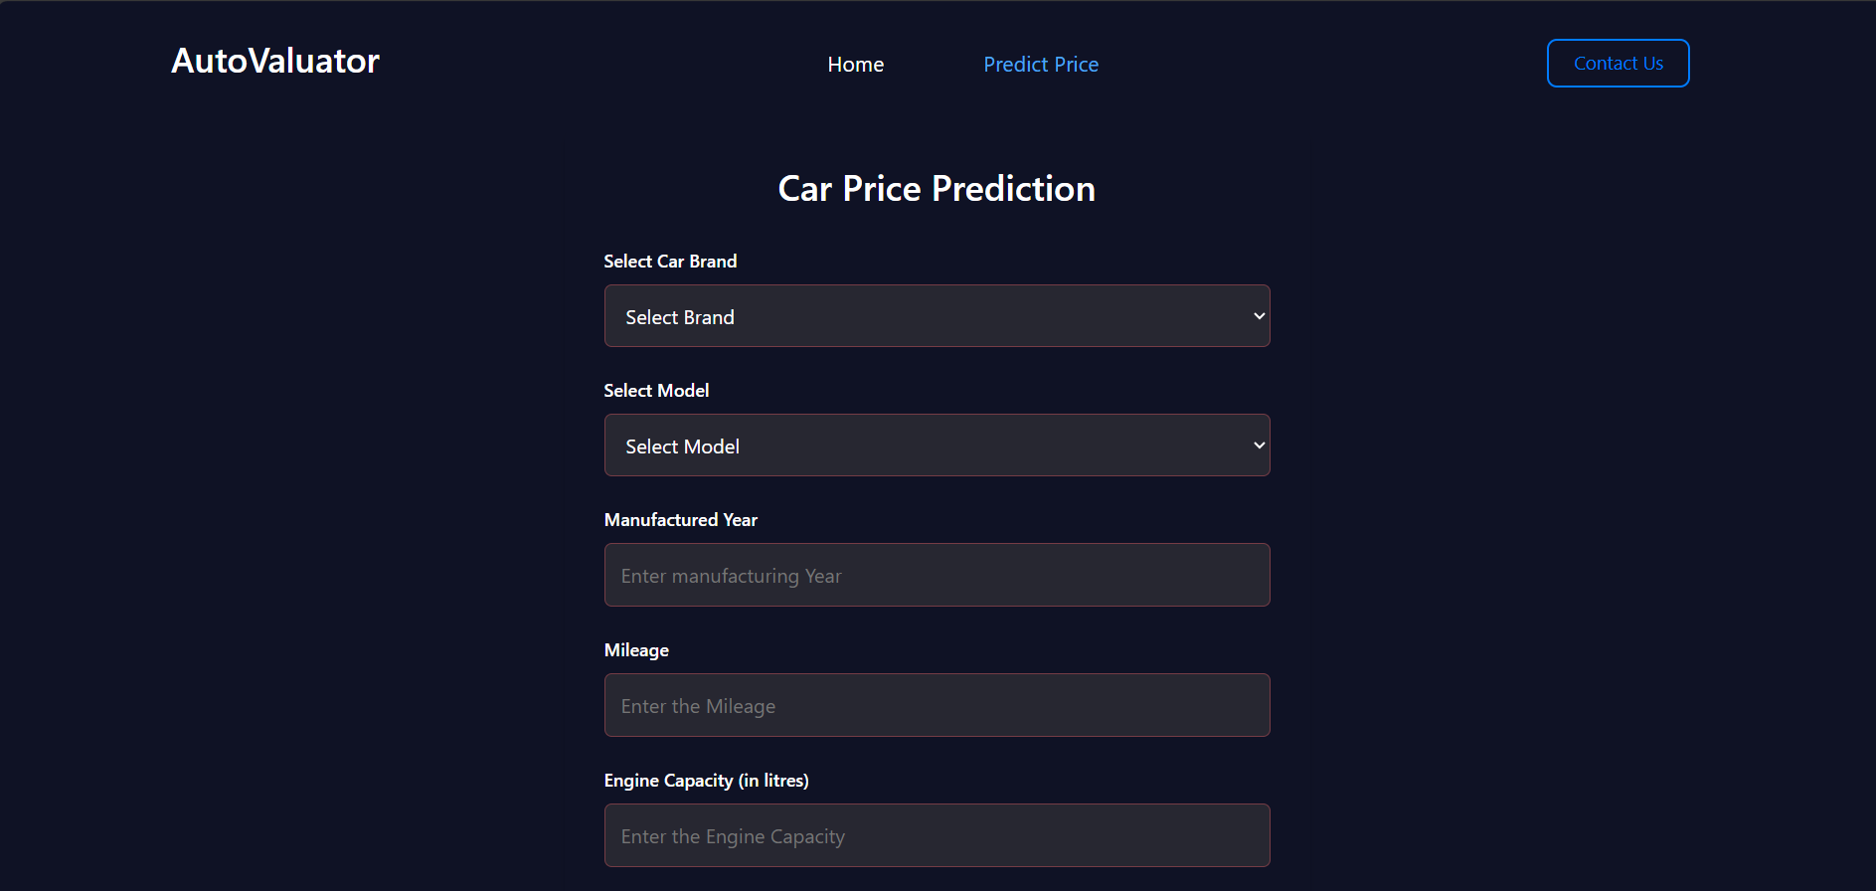
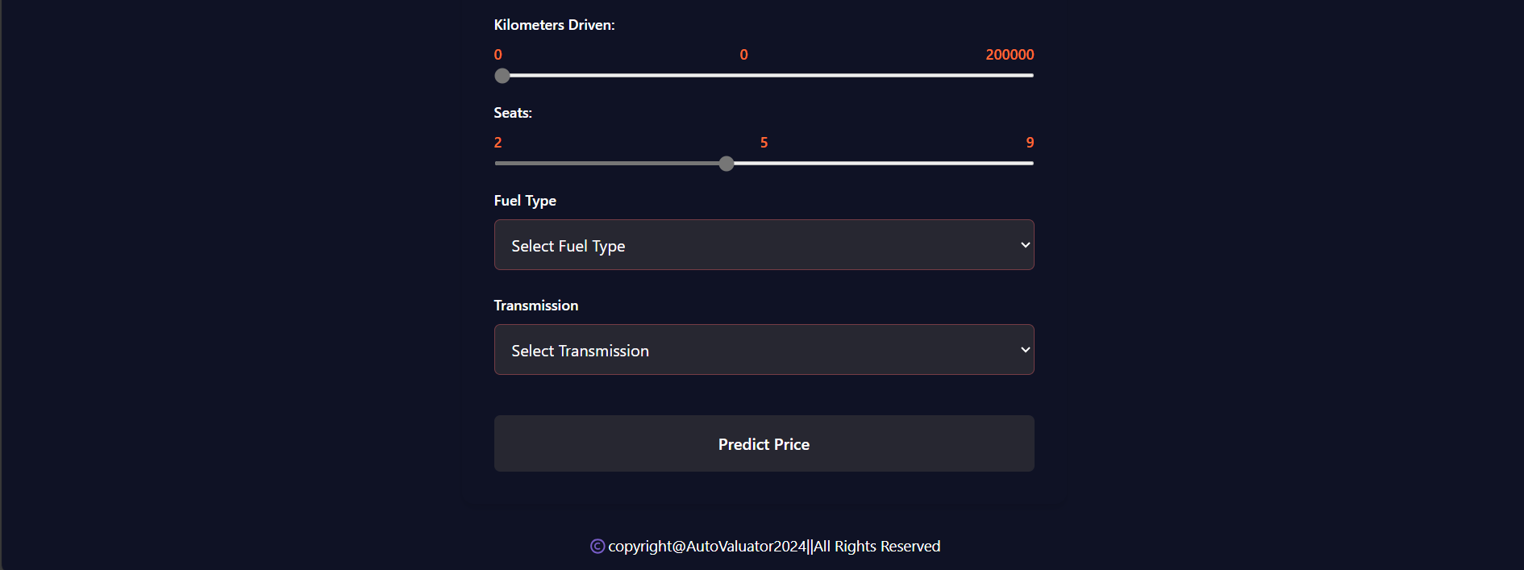
User Interface

Slide 19
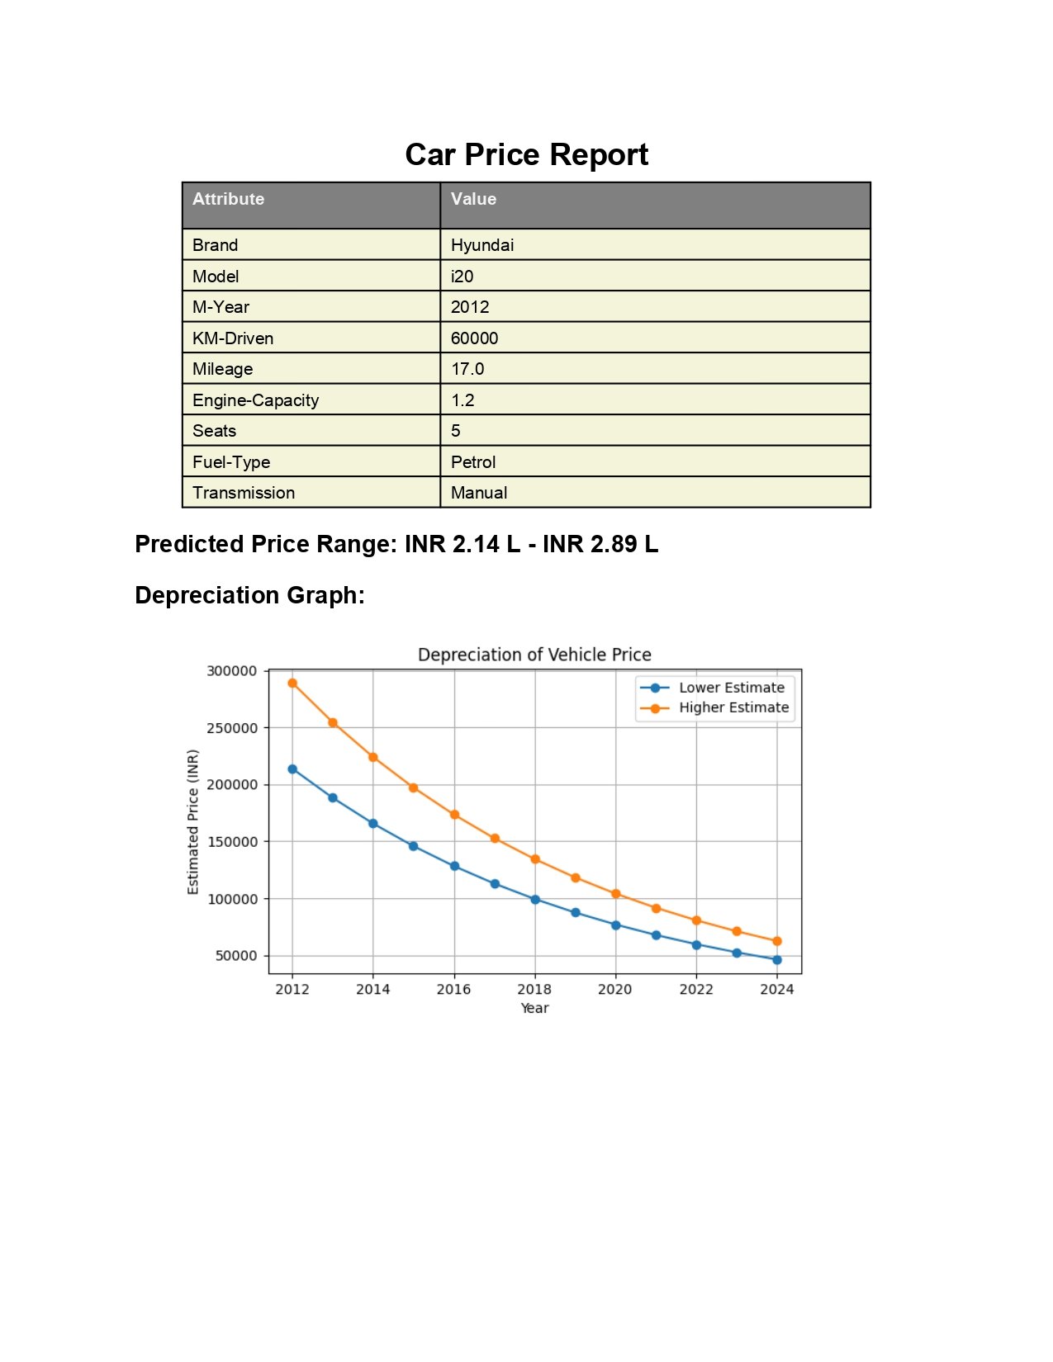
User Interface

Slide 20
Testing Plans
1. Unit Testing:
We will test individual components of the project separately — such as the form input fields, price prediction logic, and the ML model.
2. Integration Testing:
We’ll check how different parts of the system work together — for example, whether user inputs from the frontend are correctly
sent to the backend and whether the predicted price is properly shown on the frontend.
3. User Testing:
Real users will test the platform by entering car details and predicting prices to see if the UI is intuitive and the results are understandable.
4. Performance Testing:
We’ll test the platform's speed and responsiveness when multiple users use it simultaneously or when complex data is entered.
5. Security Testing: We'll test for secure data handling — especially ensuring that the user inputs are protected from common threats like injection attacks or data breaches. 6. Bug Fixing and Retesting:
After discovering any bugs, we’ll fix them and retest the full workflow — from user input to report download — to make sure everything works correctly.

Slide 21
The Outcome
Smart Price Prediction Tool
Streamlined User Experience
Improved Decision-Making
User-Friendly Web Interface
Fast & Efficient Backend
Report Download Feature
Data Privacy Focused

Slide 22
Conclusion
Helps users make informed decisions.
The project aims to make car price prediction simple and effective.
Predicts price based on user inputs like brand, model, fuel type, etc.
Offers a clean and user-friendly interface.
Uses machine learning on the backend.
Provides estimated price in just a few steps.
Helps User to make informed decisions.
Make the car-selling process faster , smarter and more convenient.

Slide 23
Q&A

Slide 24
THANKS

